Slide 1
CENG 477
Introduction to Computer Graphics
Texture Mapping

Slide 2
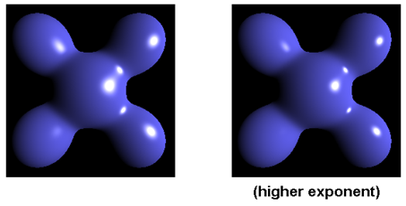
Until Now
We assumed that object have fixed R, G, B reflectance values.
Surface orientation and light direction determined the shading of objects.
Our best image so far is something like:

Slide 3
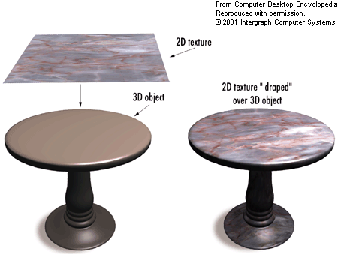
Texture Mapping
Goal: Increase visual realism by using images to simulate reflectance characteristics of objects.
A cheap and effective way to spatially vary surface reflectance.
From http://img.tfd.com

Slide 4
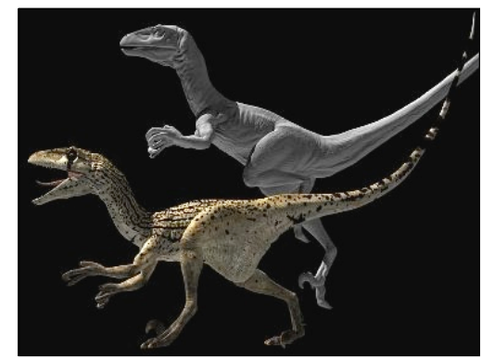
Texture Mapping
Goal: Increase visual realism by using images to simulate reflectance characteristics of objects.
A cheap and effective way to spatially vary surface reflectance.
Which one more realistic?

Slide 5
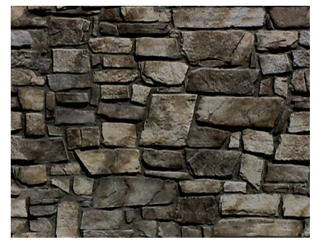
Texture Mapping
Motivation: Need millions of polygons to model this:
  Difficult and cumbersome ☹

Slide 6
Texture Mapping
Motivation: Render a simple polygon with this picture:
  Easy and cool ☺

Slide 7
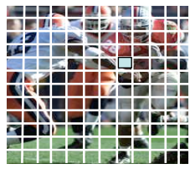
Terminology
Texture: An array of values
  2D (most common), 1D, 3D
  Color, alpha, depth, normal
Texel: A single array element
Texture mapping: The process of relating texture to geometry

Slide 8
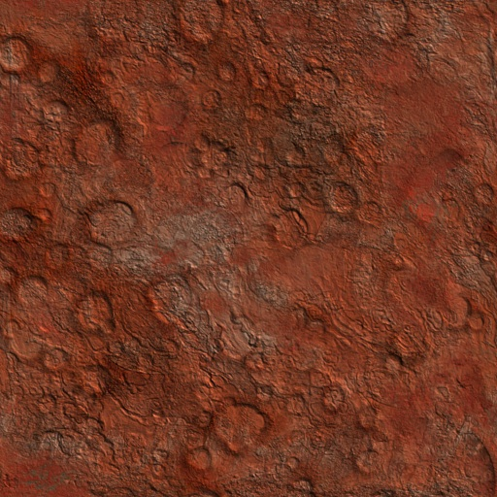
Roadmap
Step 1: Associate an (u, v) coordinate system with the texture image where (u, v) ∈ [0,1]x[0,1]
v
u

Slide 9
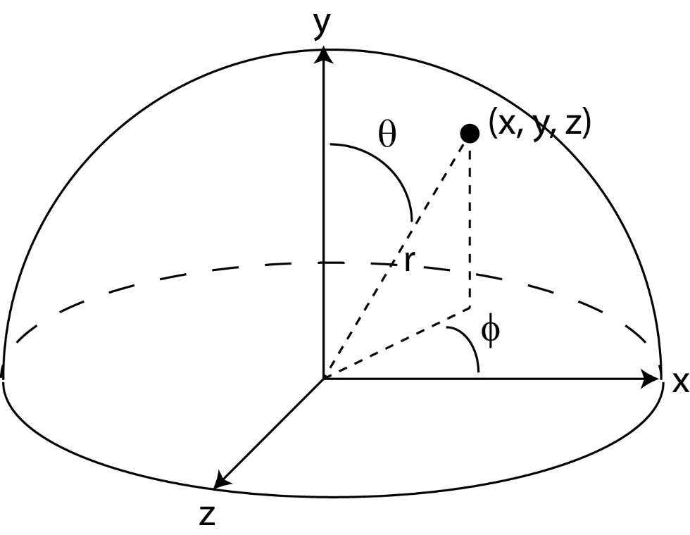
Roadmap
Step 2: Parameterize the surface to be texture mapped using two coordinates. For instance, a sphere:
Assuming that the center is at (0, 0, 0):
x = rsinΘcosϕ
y = rcosΘ
z = rsinΘsinϕ
Θ = arccos(y / r)
ϕ = arctan(z / x)
(Θ, ϕ) ∈ [0,π]x[0,2π]

Slide 10
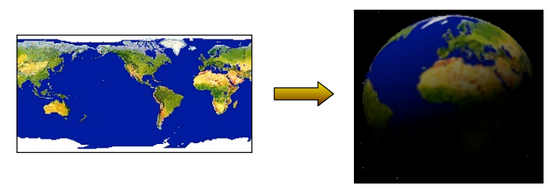
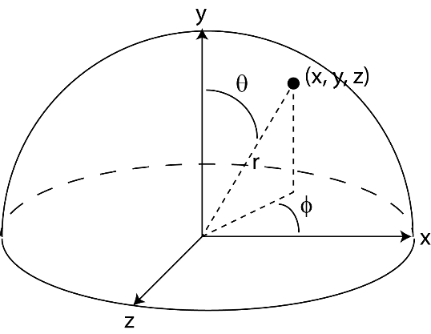
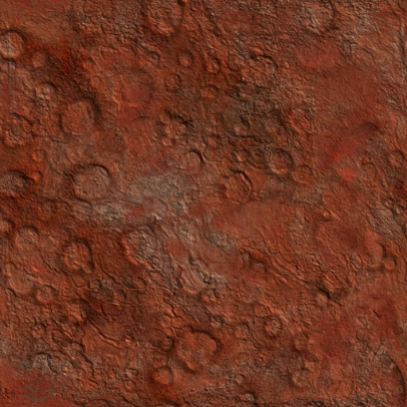
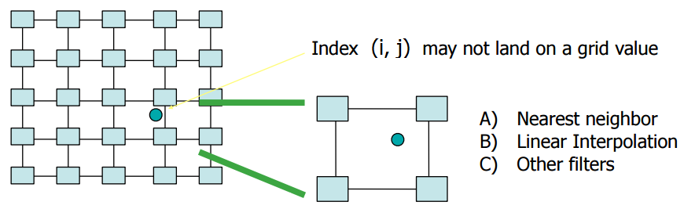
Roadmap
Step 3: Compute a (u, v) value for every surface point. For instance, a sphere:
Step 4: Find the texture image coordinate (i, j) at the given (u, v) coordinate:
u = ϕ / (2π)
v = (π – Θ) / π = 1 – Θ/ π
i = u.n_{x}
Note that i, j can be fractional!
j = v.n_{y}
n_{x} = texture image width
n_{y} = texture image height

Slide 11
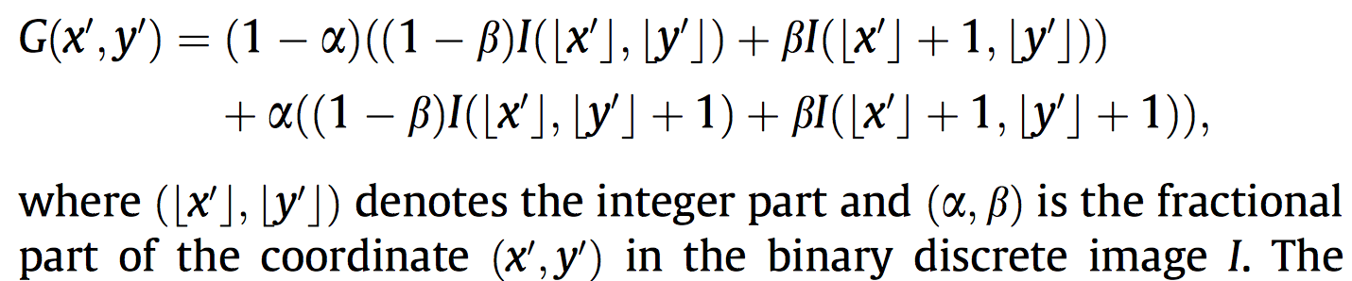
Roadmap
Step 5: Choose the texel color using a suitable interpolation strategy.
  Nearest Neighbor: fetch texel at nearest coordinate
    Color(x, y, z) = fetch(round(i, j))
  Bilinear Interpolation: Average four closest neighbors:
Color(x, y, z) = fetch(round(i, j)).(1 – a).(1 – b) +
fetch(round(i+1, j)).(a).(1 – b) +
fetch(round(i, j+1)).(1 – a).(b) +
fetch(round(i+1, j+1)).(a).(b)
(i,j)
b
a

Slide 12
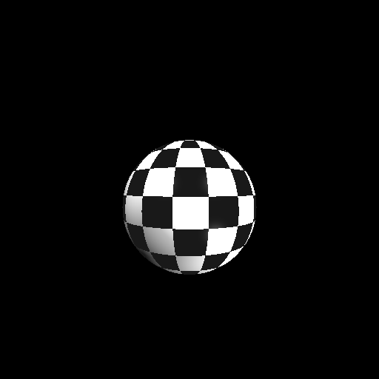
NN vs Bilinear Interpolation
Nearest-neighbor

Slide 13

NN vs Bilinear Interpolation
Bilinear

Slide 14
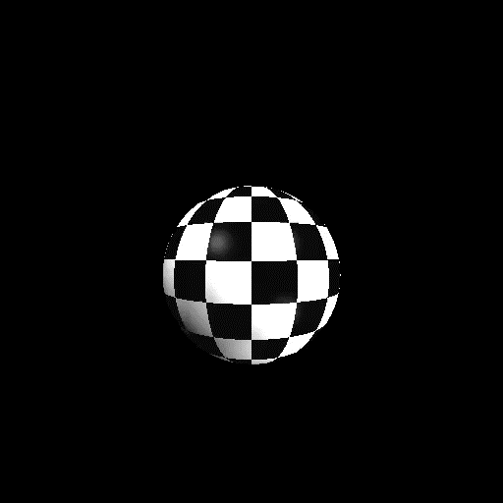

NN vs Bilinear Interpolation
Nearest-neighbor
Bilinear

Slide 15
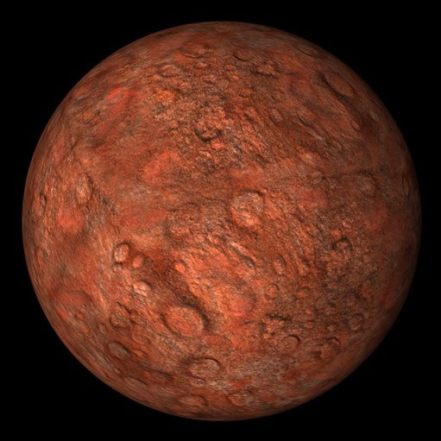
Result

Slide 16
An Interesting Usage

Slide 17
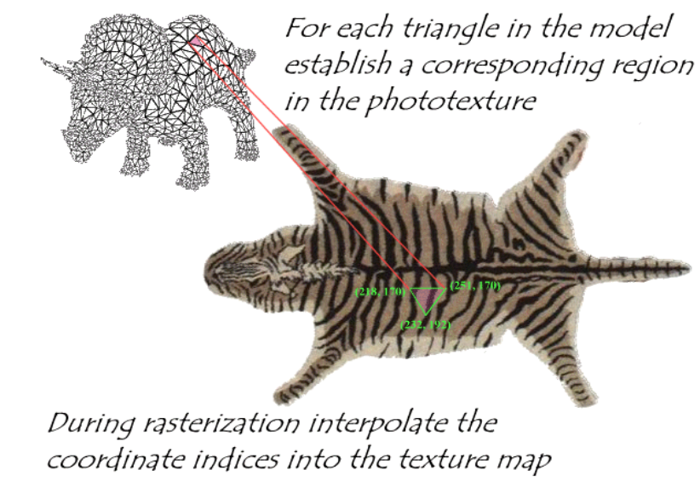
Mapping an Arbitrary Object
Need a mapping b/w the texture and object (‘s triangles)

Slide 18
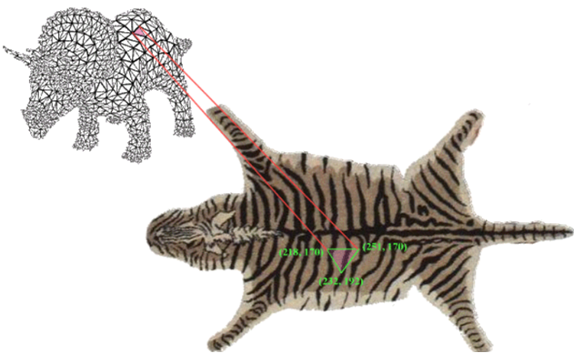
Mapping an Arbitrary Object
Need a mapping b/w the texture and object (‘s triangles)
Problems
  A 3D point on the surface maps to a location b/w texels in the texture
    Handle this by Step 5 (NN or Interpolation)
  Only 3 vertices of surface triangle are known; others’ colors?
    Any 3D point in the triangle can be represented by barycentric coordinates (interpolation)
    Apply the corresponding barycentric coordinates to the texture
      Again use Step 5 to get the integer texture coordinates
    Detailed in the next slide

Slide 19
Mapping an Arbitrary Object
First, we must associate (u, v) coordinates for each vertex
The (u, v) coordinates inside the triangle can be found using the barycentric coordinates
Recall that the position of point p at barycentric coordinates (β, γ) is equal to:
  p(β, γ) = a + β(b – a) + γ(c – a)
Texture coordinates can be interpolated similarly:
  u(β, γ) = u_{a} + β(u_{b} – u_{a}) + γ(u_{c} – u_{a})
  v(β, γ) = v_{a} + β(v_{b} – v_{a}) + γ(v_{c} – v_{a})

Slide 20
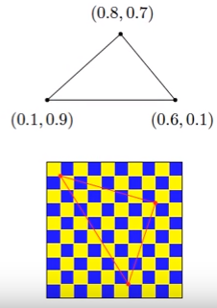
Mapping an Arbitrary Object
p(β, γ) = a + β(b – a) + γ(c – a)
u(β, γ) = u_{a} + β(u_{b} – u_{a}) + γ(u_{c} – u_{a})
v(β, γ) = v_{a} + β(v_{b} – v_{a}) + γ(v_{c} – v_{a})
β
γ
β
γ

Slide 21
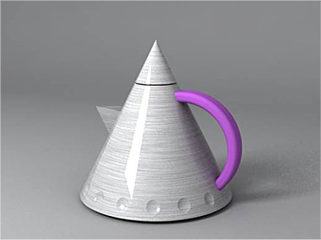
Texture Mapping and Shading
Note that texture mapping and shading are not mutually exclusive.
  Just get the base color in our shading model from the texels
    Ir = Cr*(AMBr + DIFr * n.l) + CLr * SPEr * (n.h)^{p}
    Ig = Cg*(AMBg + DIFg * n.l) + CLg * SPEg * (n.h)^{p}
    Ib = Cb*(AMBb + DIFb * n.l) + CLb * SPEb * (n.h)^{p}
From http://www.vray.com

Slide 22
Texture Mapping Approaches
Intermediate Mapping
  Map the texture onto a simple intermediate surface
  Map the intermediate surface to the final object
Intermediate objects
  Plane
  Sphere
  Cylinder
  Cube

Slide 23
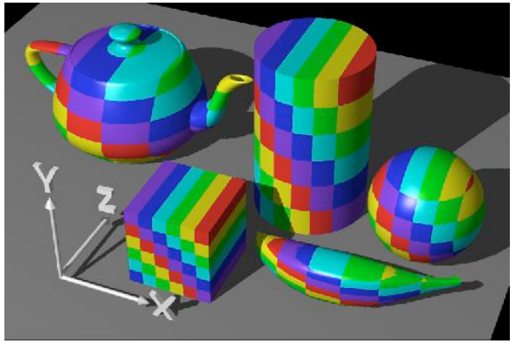
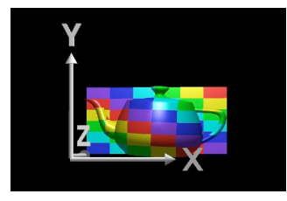
Planar Mapping
Project to an axis-aligned plane
  Drop the z coordinate if using the xy-plane: (i, j) = (x, y)

Slide 24
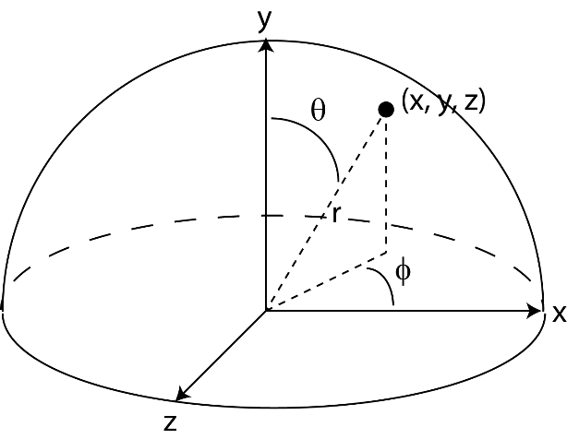
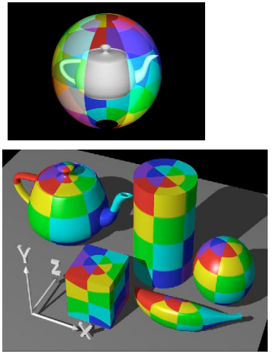
Spherical Mapping
Already seen this in Slide 9
Convert (x, y, z) into spherical coordinates (Θ, ϕ)

Slide 25
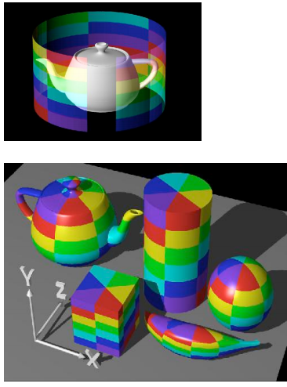
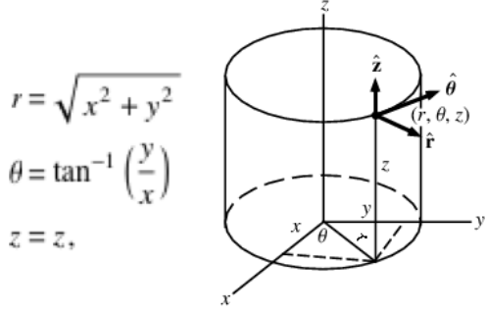
Cylindrical Mapping
Convert (x, y, z) into cylindrical coordinates (r, Θ, z)
  Use (i, j) = (Θ, z) as the texture coords

Slide 26
Texture Generation
Acquiring a 2D texture
  Scanned photo
  Artistic drawing
  Space filling X
    Stripes
    Checkerboard
    Rings

Slide 27
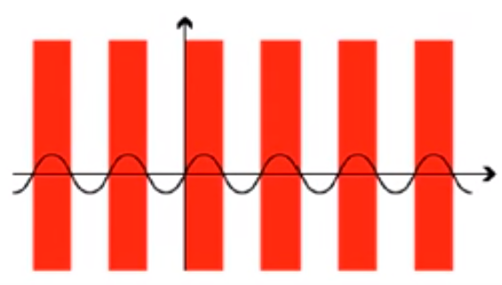
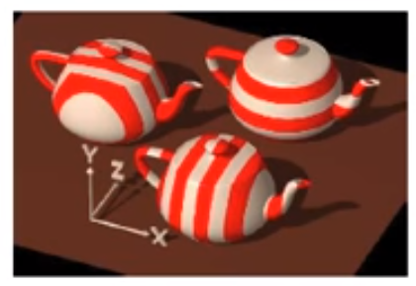
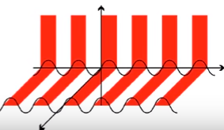
Space Filling Stripes
f(x, y, z) = color
float stripe(x, y, z) { return (sin x > 0 ? red : white); }
sin z
sin y

Slide 28
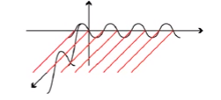
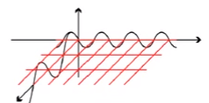
Space Filling Stripes
f(x, y, z) = color
float stripe(x, y, z) { return (sin x > 0 && sin y > 0 ? r : w); }
What to add to get a 3D checkerboard?

Slide 29


Space Filling Stripes
f(x, y, z) = color
A trigonometry trick to control the width
float stripe(x, y, z) { return (sin(π x / width) > 0? r : w); }
π 2π 3π

Slide 30

Space Filling Stripes
f(x, y, z) = smooth variation of 2+ colors
Use linear interpolation on colors to get this:
Something like: t = (1 + sin x ) / 2; color = (1-t)c0 + tc1

Slide 31
Space Filling Stripes
f(x, y, z) = color
Other alternating functions faster than sin?
float stripe(x, y, z) { return ((int)x % 2 == 0 ? r : w); }
How to set width to be W = 10?
float stripe(x, y, z) { return ((int) x % 2W in [0,W) ? r : w); }

Slide 32
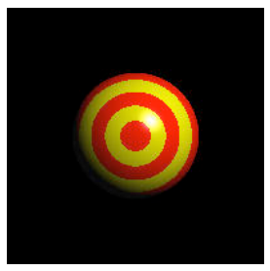
Space Filling Rings
f(x, y, z) = color
float stripe(x, y, z) { return ((int)r % 2 == 0 ? red : yel); } where r = sqrt(x² + y²)

Slide 33
Mipmapping
Consider three cases where
  The polygon that is texture mapped is the same size (in screen space) as the texture image.
  The polygon that is texture mapped is larger than the texture image. //viewer is close → magnify texture
  The polygon that is texture mapped is smaller than the texture image. //viewer is far → minify texture

Slide 34
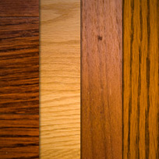
Mipmapping
Polygon same size as texture (map as usual):
texels pixels
Map
Result

Slide 35
Mipmapping
Polygon larger (texture needs to be magnified):
Map
Result

Slide 36
Mipmapping
Polygon smaller (texture needs to be minified):
Map
Result

Slide 37
Mipmapping
Minification: A change of 1 pixel in image space causes a change of >1pixel in texture space.
To avoid artifacts, one should use the average all texels that should fall on the same image pixel.
Map

Slide 38
Mipmapping
Take the extreme case: a 1 pixel change on image space corresponds to as many pixels as the width of the texture in texture space:
Reading the entire texture image to compute the average color is clearly inefficient in this case.
Map

Slide 39
Mipmapping
No such problem in magnification though
  constant (4 pixels) lookup
Map
1 2
3 4
Result

Slide 40
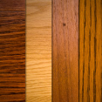

Mipmapping
Solution: Pre-filter images to create smaller resolution versions:
Then sample from the appropriate resolution in run-time.
Memory requirement – how much memory does a mipmap chain require?
A + A/4 + A/16 + A/64 + … = 4A/3

Slide 41
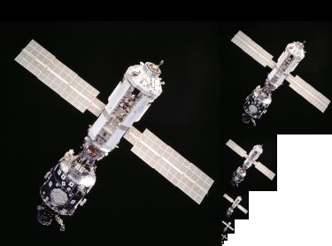
Mipmapping
Mipmaps are pre-calculated, optimized sequences of images, each of which is a progressively lower resolution representation of the same image
Mipmapping is mainly there for efficiency (minification)

Slide 42
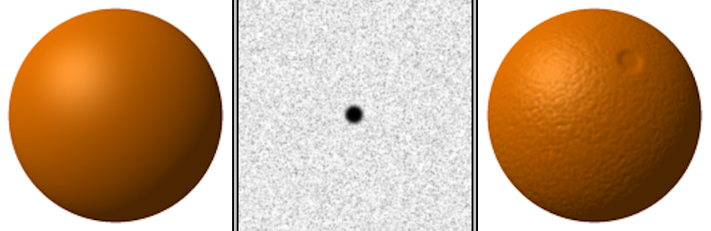
Bump Mapping
So far we used images of color for textures
Idea of having pre-calculated values and interpolating them over our object extends to different values
  Colors → Vectors (normals)

Slide 43
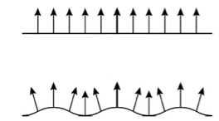
Bump Mapping
Idea: bumps cause slightly different reflections of light

Slide 44
Bump Mapping
Bump maps (array of vectors) are added to the normals

Slide 45
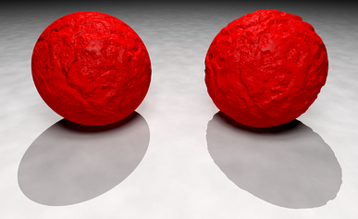
Displacement Mapping
Bump mapping is limited in that it does not modify the geometry (just alters the normals)
Displacement Mapping actually alters the geometry
Displacement maps (array of vectors) are added to the points
  Note the unrealistic (bump) and realistic (displacement) shadows

Slide 46
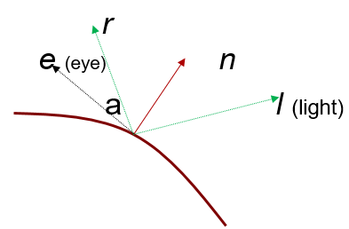
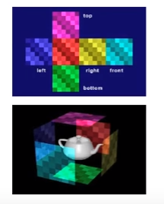
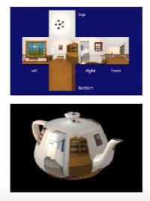
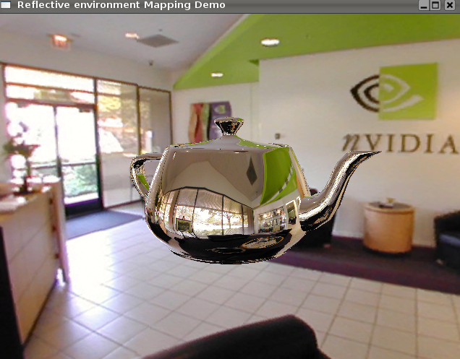
Environment Mapping
Aka Reflection Mapping
Place a cube around the object and project the environmnt of the obj onto the planes of the cube: our texture map
During rendering, compute reflection vector r and use that to lookup texture values from the cubic texture map

